Slide 1
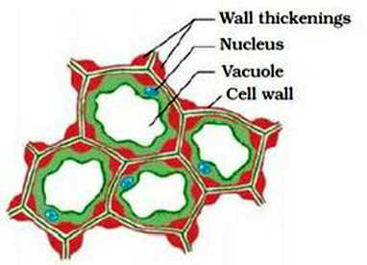
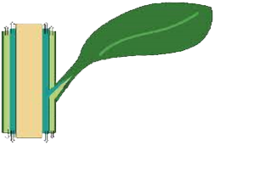
Simple permanent tissue
iv. Collenchyma :
The cells of this tissue are living, elongated
This tissue is located in leaf stalks below the epidermis.
It gives flexibility and allows easy bending of various parts of plants like leaves stem and twigs.
It also provides mechanical support to young plants.
and irregularly thickened at the corners with cellulose.
A type of carbohydrate
The part that connects leaf to a stem
Outer layer
Leaf stalk

Slide 2
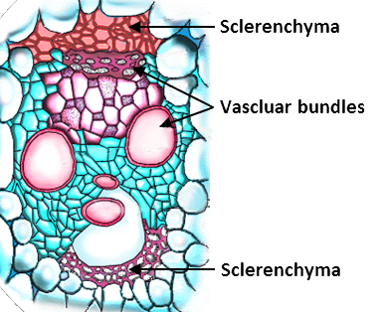
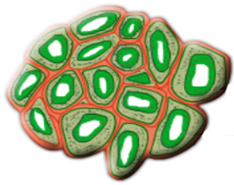
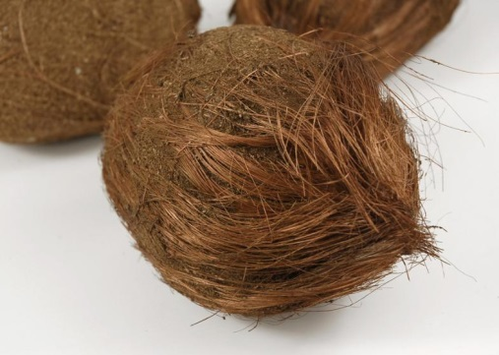
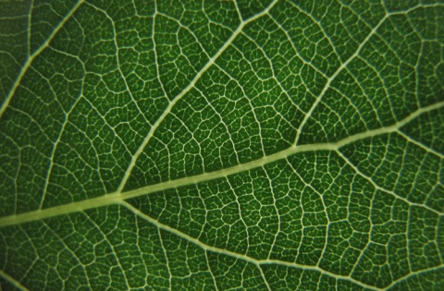
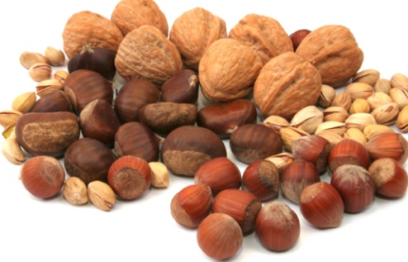
Simple permanent tissue
v. Sclerenchyma :
Lignified thick wall
The cells of this tissue are dead. They are elongated and narrow.
The cell walls are thickened due to deposition of lignin.
The walls are so thick that there is no internal space inside the cell
This tissue is located in the stems around vascular bundles, in the veins of the leaves and in the hard covering of seeds and nuts.
Due to the specific structure, the tissue makes the plants hard and stiff.
It provides strength to the parts of the plants. For E.g. Husk of the coconut.
It acts as cement and hardens the walls.
An organic substance binding the cells.
Xylem and phloem

Slide 3
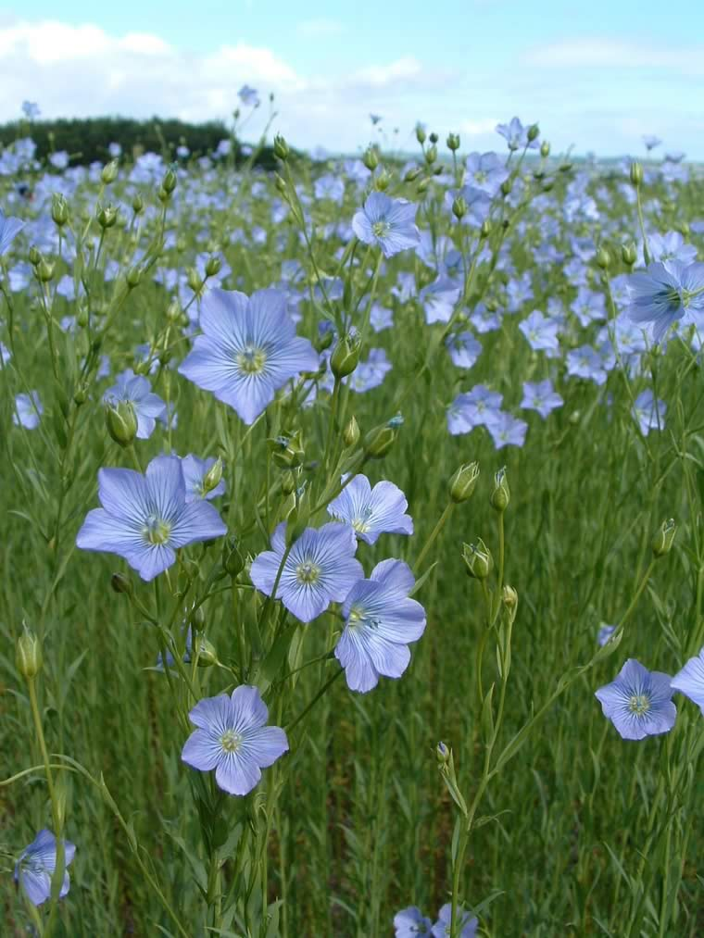
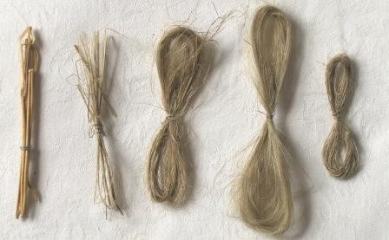
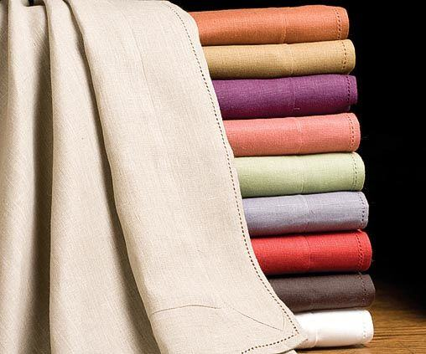
Simple permanent tissue
v. Sclerenchyma :
Linen a fine cloth made from sclerenchyma fibres of Flax plant.
Have you heard about Linen?

